Slide 1
Data and Datasets
AI 4 Business

Slide 2
Outline
Basic Terminology
The Database Approach
Using a Database System

Slide 3
Basic Terminology

Slide 4
Most Basic Terminology
Data: known facts that can be recorded and that have implicit meaning
Database: collection of related data (logically coherent)
Represents some aspects of the real world (miniworld)
Built for a specific purpose
Examples of large databases
Amazon.com's product data
Data collection underlying Webreg
Database Technology
Topic 1: Introduction
4

Slide 5
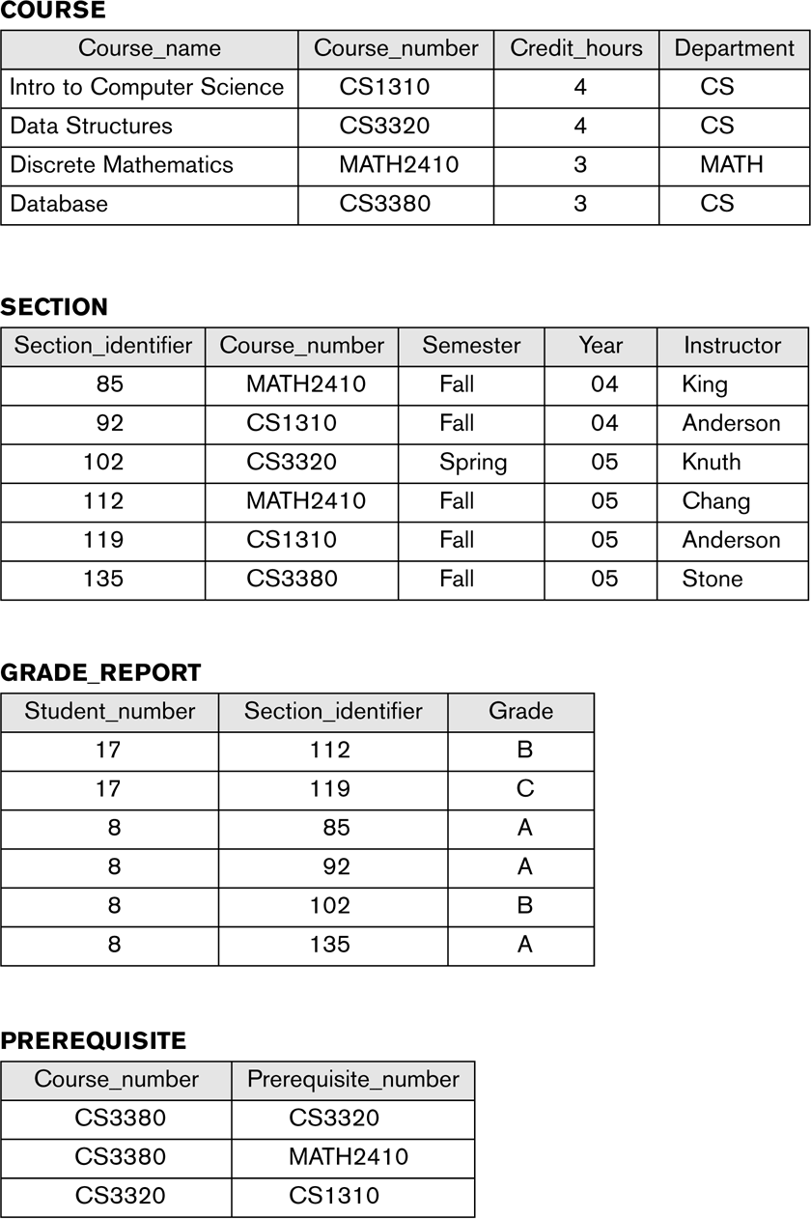
Example of a Database

Slide 6
Terminology (cont'd)
Database management system (DBMS)
Collection of computer programs
Enables users to create and maintain a database (DB)
Supports concurrent access to a database by multiple users and programs
Protects the DB against unauthorized access and manipulation
Provides means to evolve the DB as requirements change
Examples of database management systems
IBM’s DB2, Microsoft’s Access, Microsoft’s SQL Server, Oracle, SAP’s SQL Anywhere, MySQL, PostgreSQL
Database Technology
Topic 1: Introduction
6

Slide 7
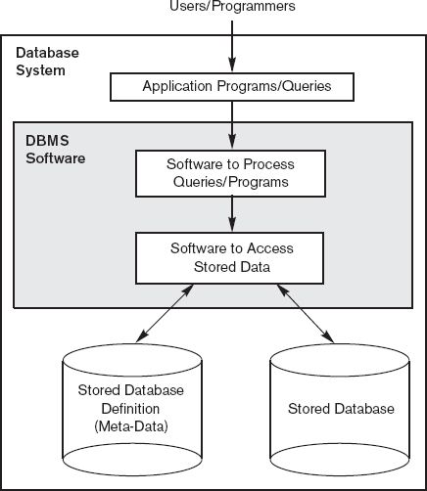
Database System

Slide 8
The Database Approach

Slide 9

Pre-DBMS Data Management
▪
Used traditional file processing
Each user defines and implements the files needed for a specific software application
▪
As the application base grows
many shared files
a multitude of file structures
https://www.goodfreephotos.com/albums/other-photos/boxes-and-boxes-moving-storage.jpg
a need to exchange data among applications

Slide 10

Problems of Pre-DBMS Data Management
▪ Redundancy: multiple copies
▪ Inconsistency: independent updates
▪ Inaccuracy: concurrent updates
▪ Incompatibility: multiple formats
▪ Insecurity: proliferation
▪ Inauditability: poor chain of responsibility
▪ Inflexibility: changes are difficult to apply
https://cdn.pixabay.com/photo/2014/06/01/22/26/clutter-360058_960_720.jpg
Database Technology
Topic 1: Introduction
10

Slide 11

Database Approach
▪ Eventually recognized that data is a critical corporate asset (along with capital and personnel)
Need to manage the data in a more systematic manner
▪ Database approach: Use a single repository to maintain data that is defined once and accessed by various users
Addresses the aforementioned problems
https://cdn.pixabay.com/photo/2017/06/12/04/21/database-2394312_960_720.jpg

Slide 12
Characteristics of the Database Approach
▪ Programs isolated from data through abstraction
DBMS does not expose details of how (or where) data is stored or how operations are implemented
Programs refer to an abstract model of the data, rather than data storage details
Data structures and storage organization can be changed without having to change the application programs
▪ Support of multiple views of the data
Different users may see different views of the database,which contain only the data of interest to these users
▪ Multi-user transaction processing
Encapsulates sequence of operations to behave atomically
e.g., transferring funds
Database Technology
Topic 1: Introduction
12

Slide 13
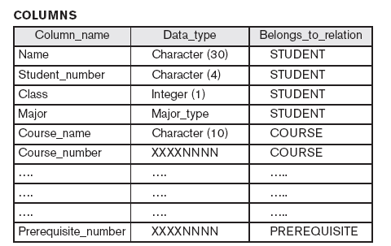
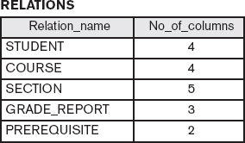
Characteristics of the Database Approach
▪ Data is self-describing
Database system contains a database catalog with meta-data that describes structure and constraints of the database(s)
Database catalog used by DBMS, and by DB users who need information about DB structure
Example:
Database Technology
Topic 1: Introduction
13
Example from “Fundamentals of Database Systems” by Elmasri and Navathe, Addison Wesley.

Slide 14
Using a Database System

Slide 15
Defining a Database
▪
Specifying the data types, structures, and constraints of the data to be stored
Uses a Data Definition Language (DDL)
Meta-data: Database definition or descriptive information
Stored by the DBMS in a database catalog or data dictionary
▪
▪
▪
Phases for designing a database:
Requirements specification and analysis
Conceptual design
e.g., using the Entity-Relationship model
Logical design
e.g., using the relational model
Physical design
Database Technology
Topic 1: Introduction
15

Slide 16
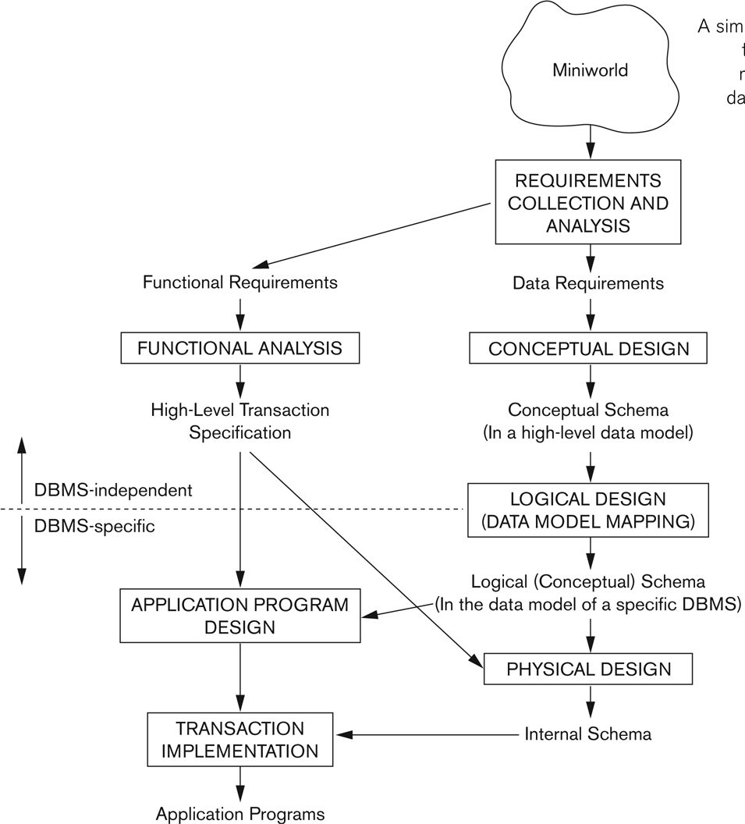
Database System Design Process
▪
Two main activities:
Database design focuses on defining the database
Application design focuses on the programs and interfaces that access the database
(out of scope of this lecture)
16
Figure from “Fundamentals of Database Systems” by Elmasri and Navathe, Addison Wesley.

Slide 17
Example of Data Requirements
A taxi company needs to model their activities.
There are two types of employees in the company: drivers and operators. For drivers it is interesting to know the date of issue and type of the driving license, and the date of issue of the taxi driver’s certificate. For all employees it is interesting to know their personal number, address and the available phone numbers.
The company owns a number of cars. For each car there is a need to know its type, year of manufacturing, number of places in the car and date of the last service.
The company wants to have a record of car trips. A taxi may be picked on a street or ordered through an operator who assigns the order to a certain driver and a car.
Departure and destination addresses together with times
should also be recorded.
Database Technology
Topic 1: Introduction
17

Slide 18
Another Example
▪
▪
Movie database: information concerning movies, actors, awards
Data records
Film
Person
Role
Honors
Define structure of each type of data record by specifying
data elements to include and data type for each element
String (sequence of alphabetic characters)
Numeric (integer or real)
Date (year or year-month-day)
Monetary amount
etc.
▪
Database Technology
Topic 1: Introduction
18

Slide 19
Using a Database
▪
Populating a DB: Inserting data to reflect the miniworld
e.g., store data to represent each film, actor, role, director, etc
Film
title | genre | year | director | runtime | budget | gross
The Company
Men | drama | 2010 | John Wells | 104 | 15,000,000 | 4,439,063
Lincoln | biography | 2012 | Steven Spielberg | 150 | 65,000,000 | 181,408,467
War Horse | drama | 2011 | Steven Spielberg | 146 | 66,000,000 | 79,883,359
Argo | drama | 2012 | Ben Affleck | 120 | 44,500,000 | 135,178,251
Fire Sale | comedy | 1977 | Alan Arkin | 88 | 1,500,000 | 0
Person
name | birth | city
Ben Affleck | 1972 | Berkeley
Alan Arkin | 1934 | New York
Tommy Lee Jones | 1946 | San Saba
John Wells | 1957 | Alexandria
Steven Spielberg | 1946 | Cincinnati
Daniel Day-Lewis | 1957 | Greenwich
Honors
movie | award | category | winner
Lincoln | Critic's Choice | actor | Daniel Day-Lewis
Argo | Critic's Choice | director | Ben Affleck
Lincoln | Screen Actors Guild | supporting actor | Tommy Lee Jones
Lincoln | Screen Actors Guild | actor | Daniel Day-Lewis
Lincoln | Critic's Choice | screenplay | Tony Kushner
Argo | Screen Actors Guild | cast | Argo
War Horse | BMI Flim | music | John Williams
Role
actor
movie
persona
Ben Affleck Alan Arkin Ben Affleck
Argo Argo
Tony Mendez Lester Siegel
The Company Men Bobby Walker
Tommy Lee Jones The Company Men Gene McClary Tommy Lee Jones Lincoln
Alan Arkin Fire Sale
Thaddeus Stevens Ezra Fikus Abraham Lincoln
Daniel Day-Lewis Lincoln

Slide 20
Using a Database (cont'd)
▪
▪
Populating a DB: Inserting data to reflect the miniworld
Query: Interaction causing some data to be retrieved
Uses a Query Language
▪
Examples of queries:
List the cast of characters for Lincoln.
Who directed a drama in 2012?
Who directed a film in which he or she also played a role?
What awards were won by War Horse?

Slide 21
Using a Database (cont'd)
▪
▪
Populating a DB: Inserting data to reflect the miniworld
Query: Interaction causing some data to be retrieved
Uses a Query Language
Manipulating a DB
Querying and updating the DB to understand/reflect miniworld
Generating reports
Uses a Data Manipulation Language (DML)
▪
▪
Examples of updates:
Record that Argo won a Golden Globe award for best picture.
Add another $395,533 to the gross earnings for Lincoln.
Change the birthplace for Daniel Day-Lewis to London.
Delete all data about the movie Fire Sale from the database.

Slide 22
Using a Database (cont'd)
▪
▪
Populating a DB: Inserting data to reflect the miniworld
Query: Interaction causing some data to be retrieved
Uses a Query Language
Manipulating a DB
Querying and updating the DB to understand/reflect miniworld
Generating reports
Uses a Data Manipulation Language (DML)
Application program
Accesses DB by sending queries and updates to DBMS
▪
▪

Slide 23
Reorganizing a Database
▪
▪
Changes the metadata rather than the data More drastic than data updates
May require massive changes to the data
May require changes to some application programs
Uses the Data Definition Language (DDL) again Examples:
Move director from FILM to a separate relation DIRECTOR with columns for person and movie
Change birth from yyyy to yyyy/mm/dd
Split name in PERSON to separate surname from given names.
Include data element movieID in FILM (to accommodate remakes and other duplications of film title); update other relations accordingly
▪
▪
Database Technology
Topic 1: Introduction
23

